Slide 1

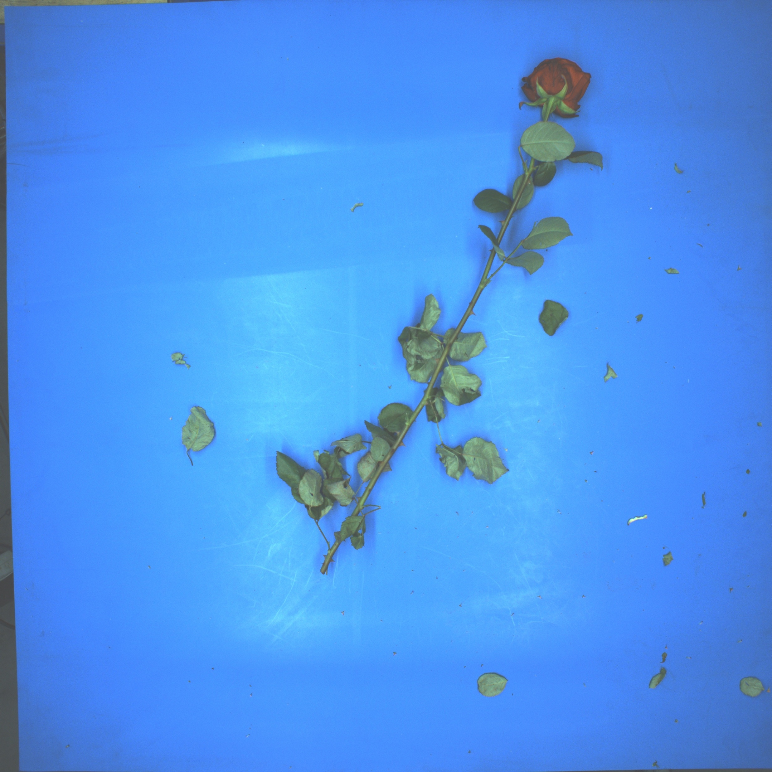
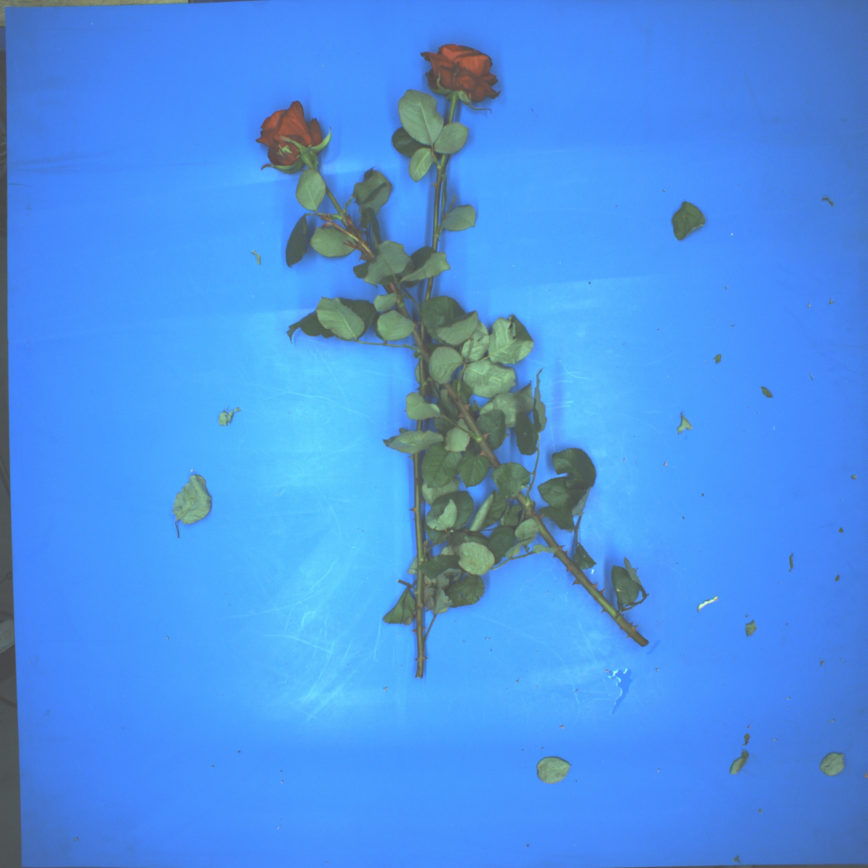
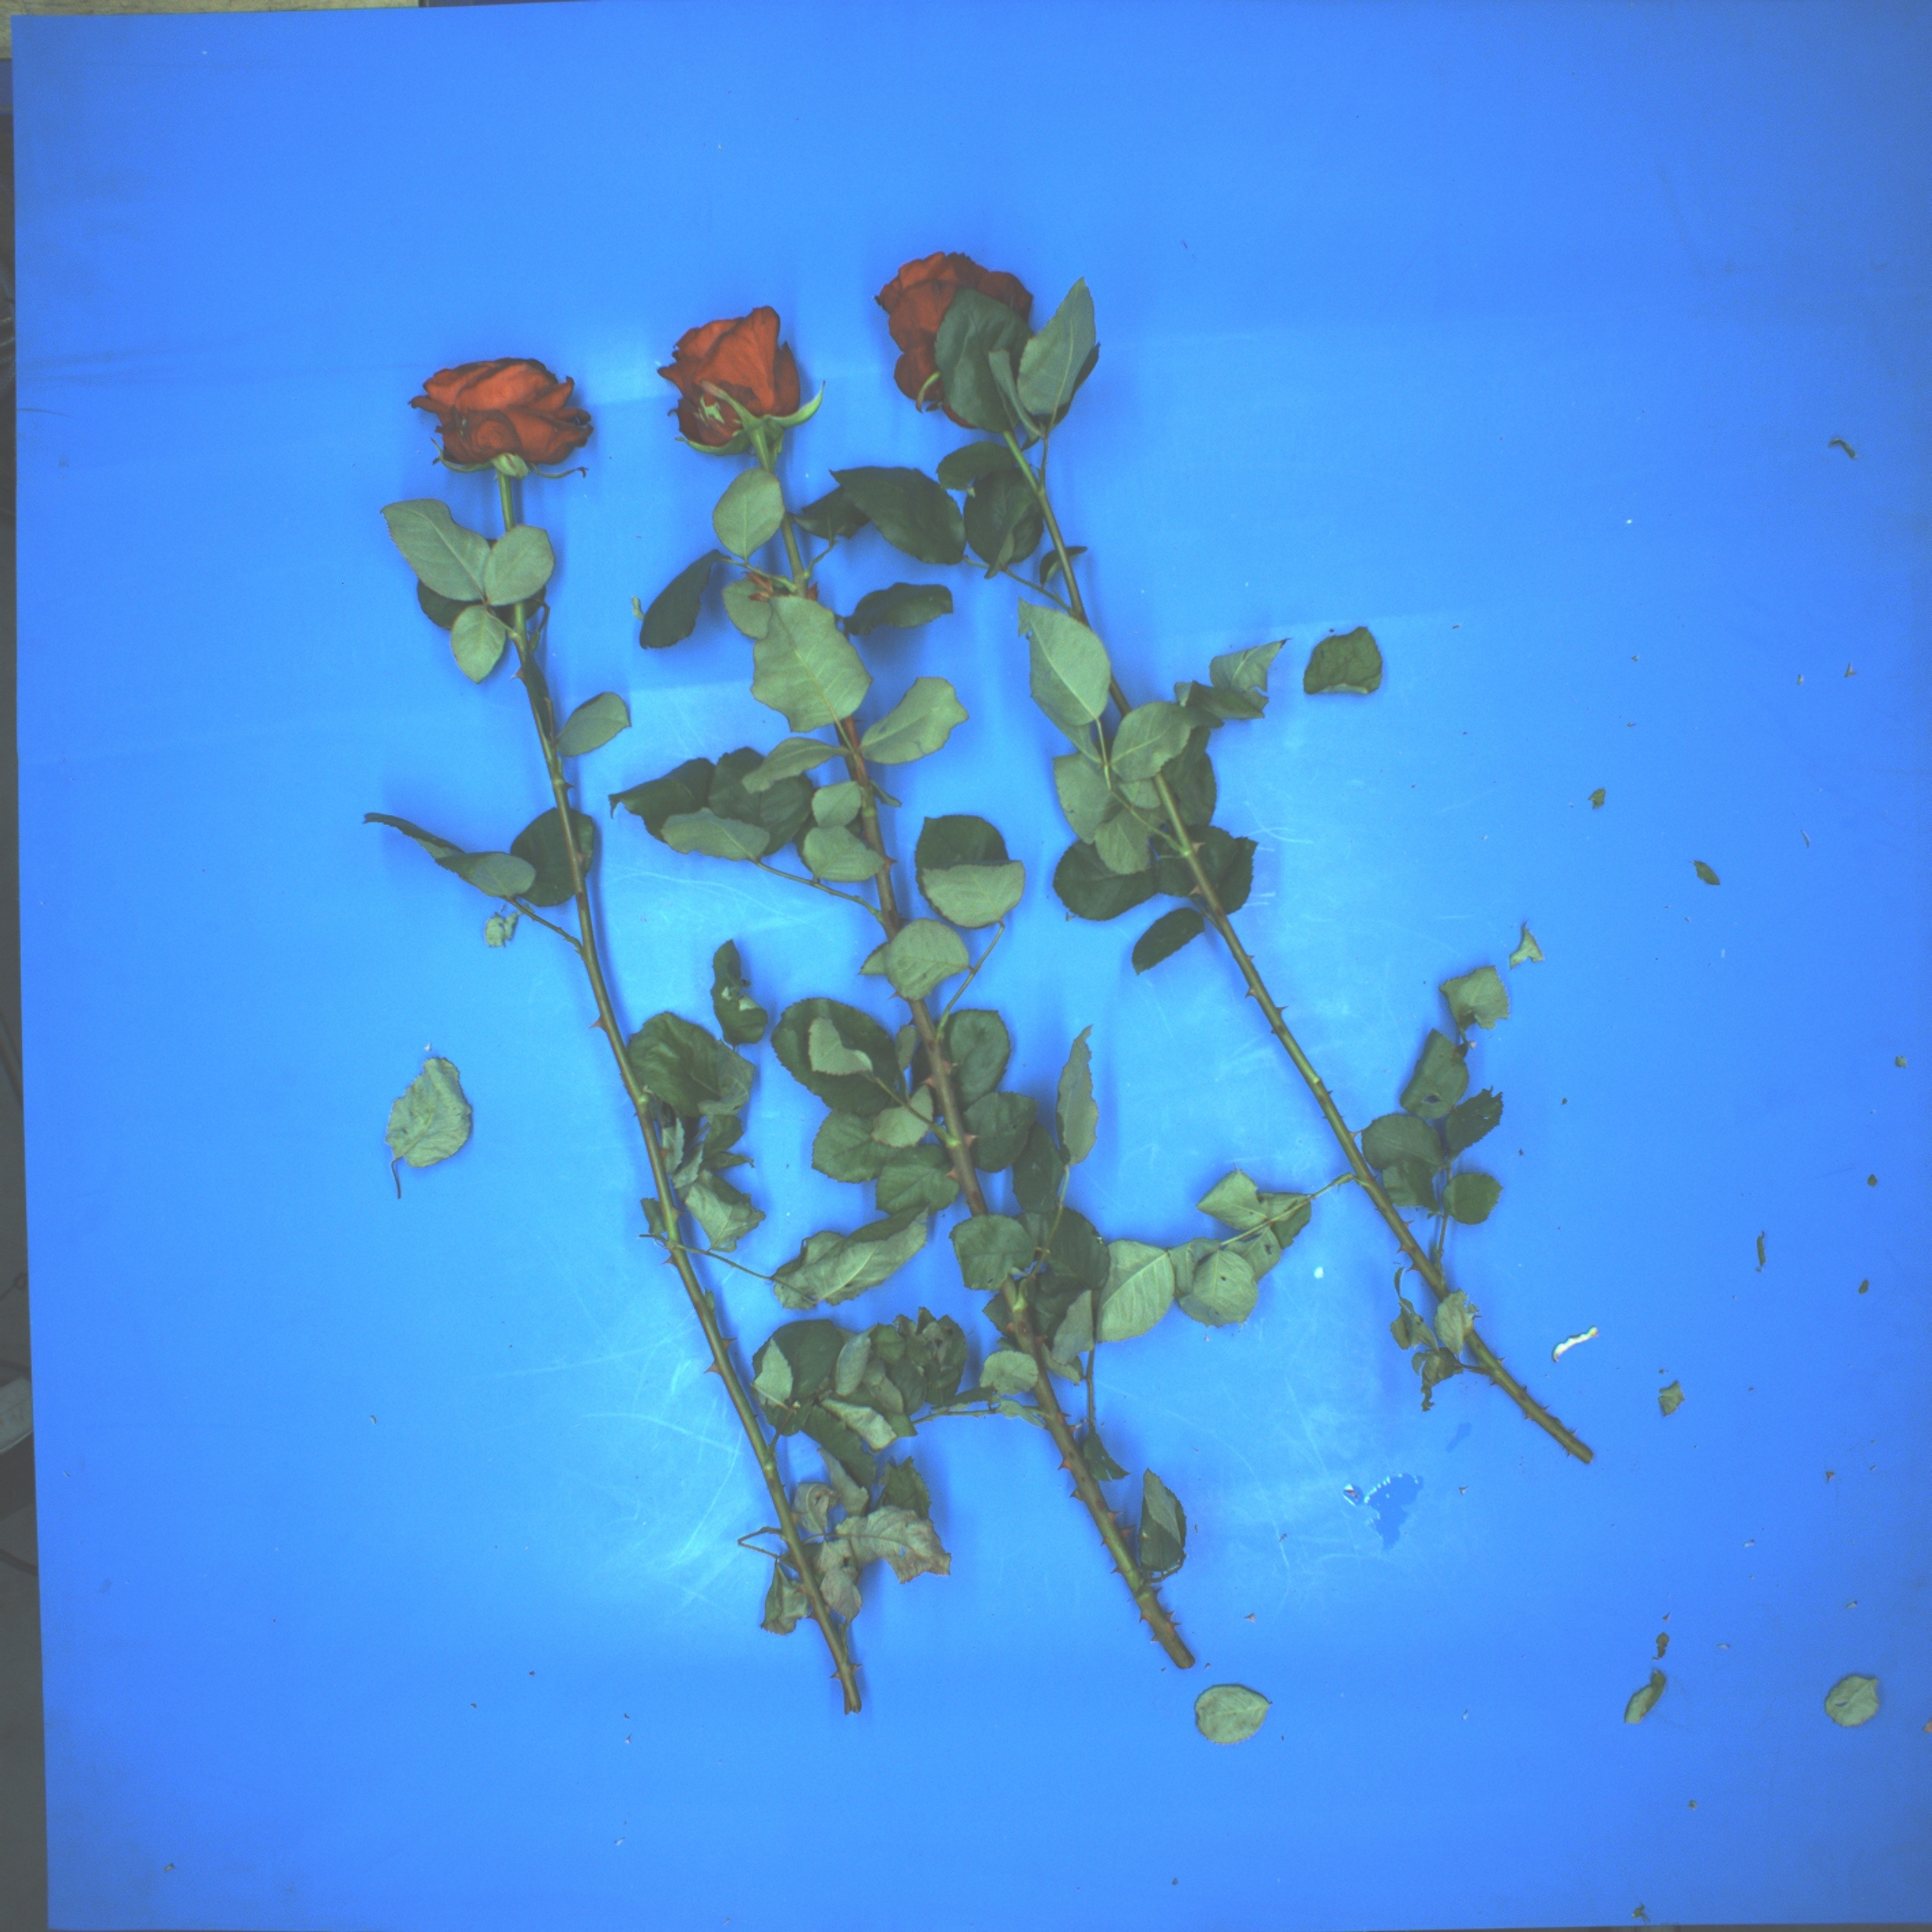
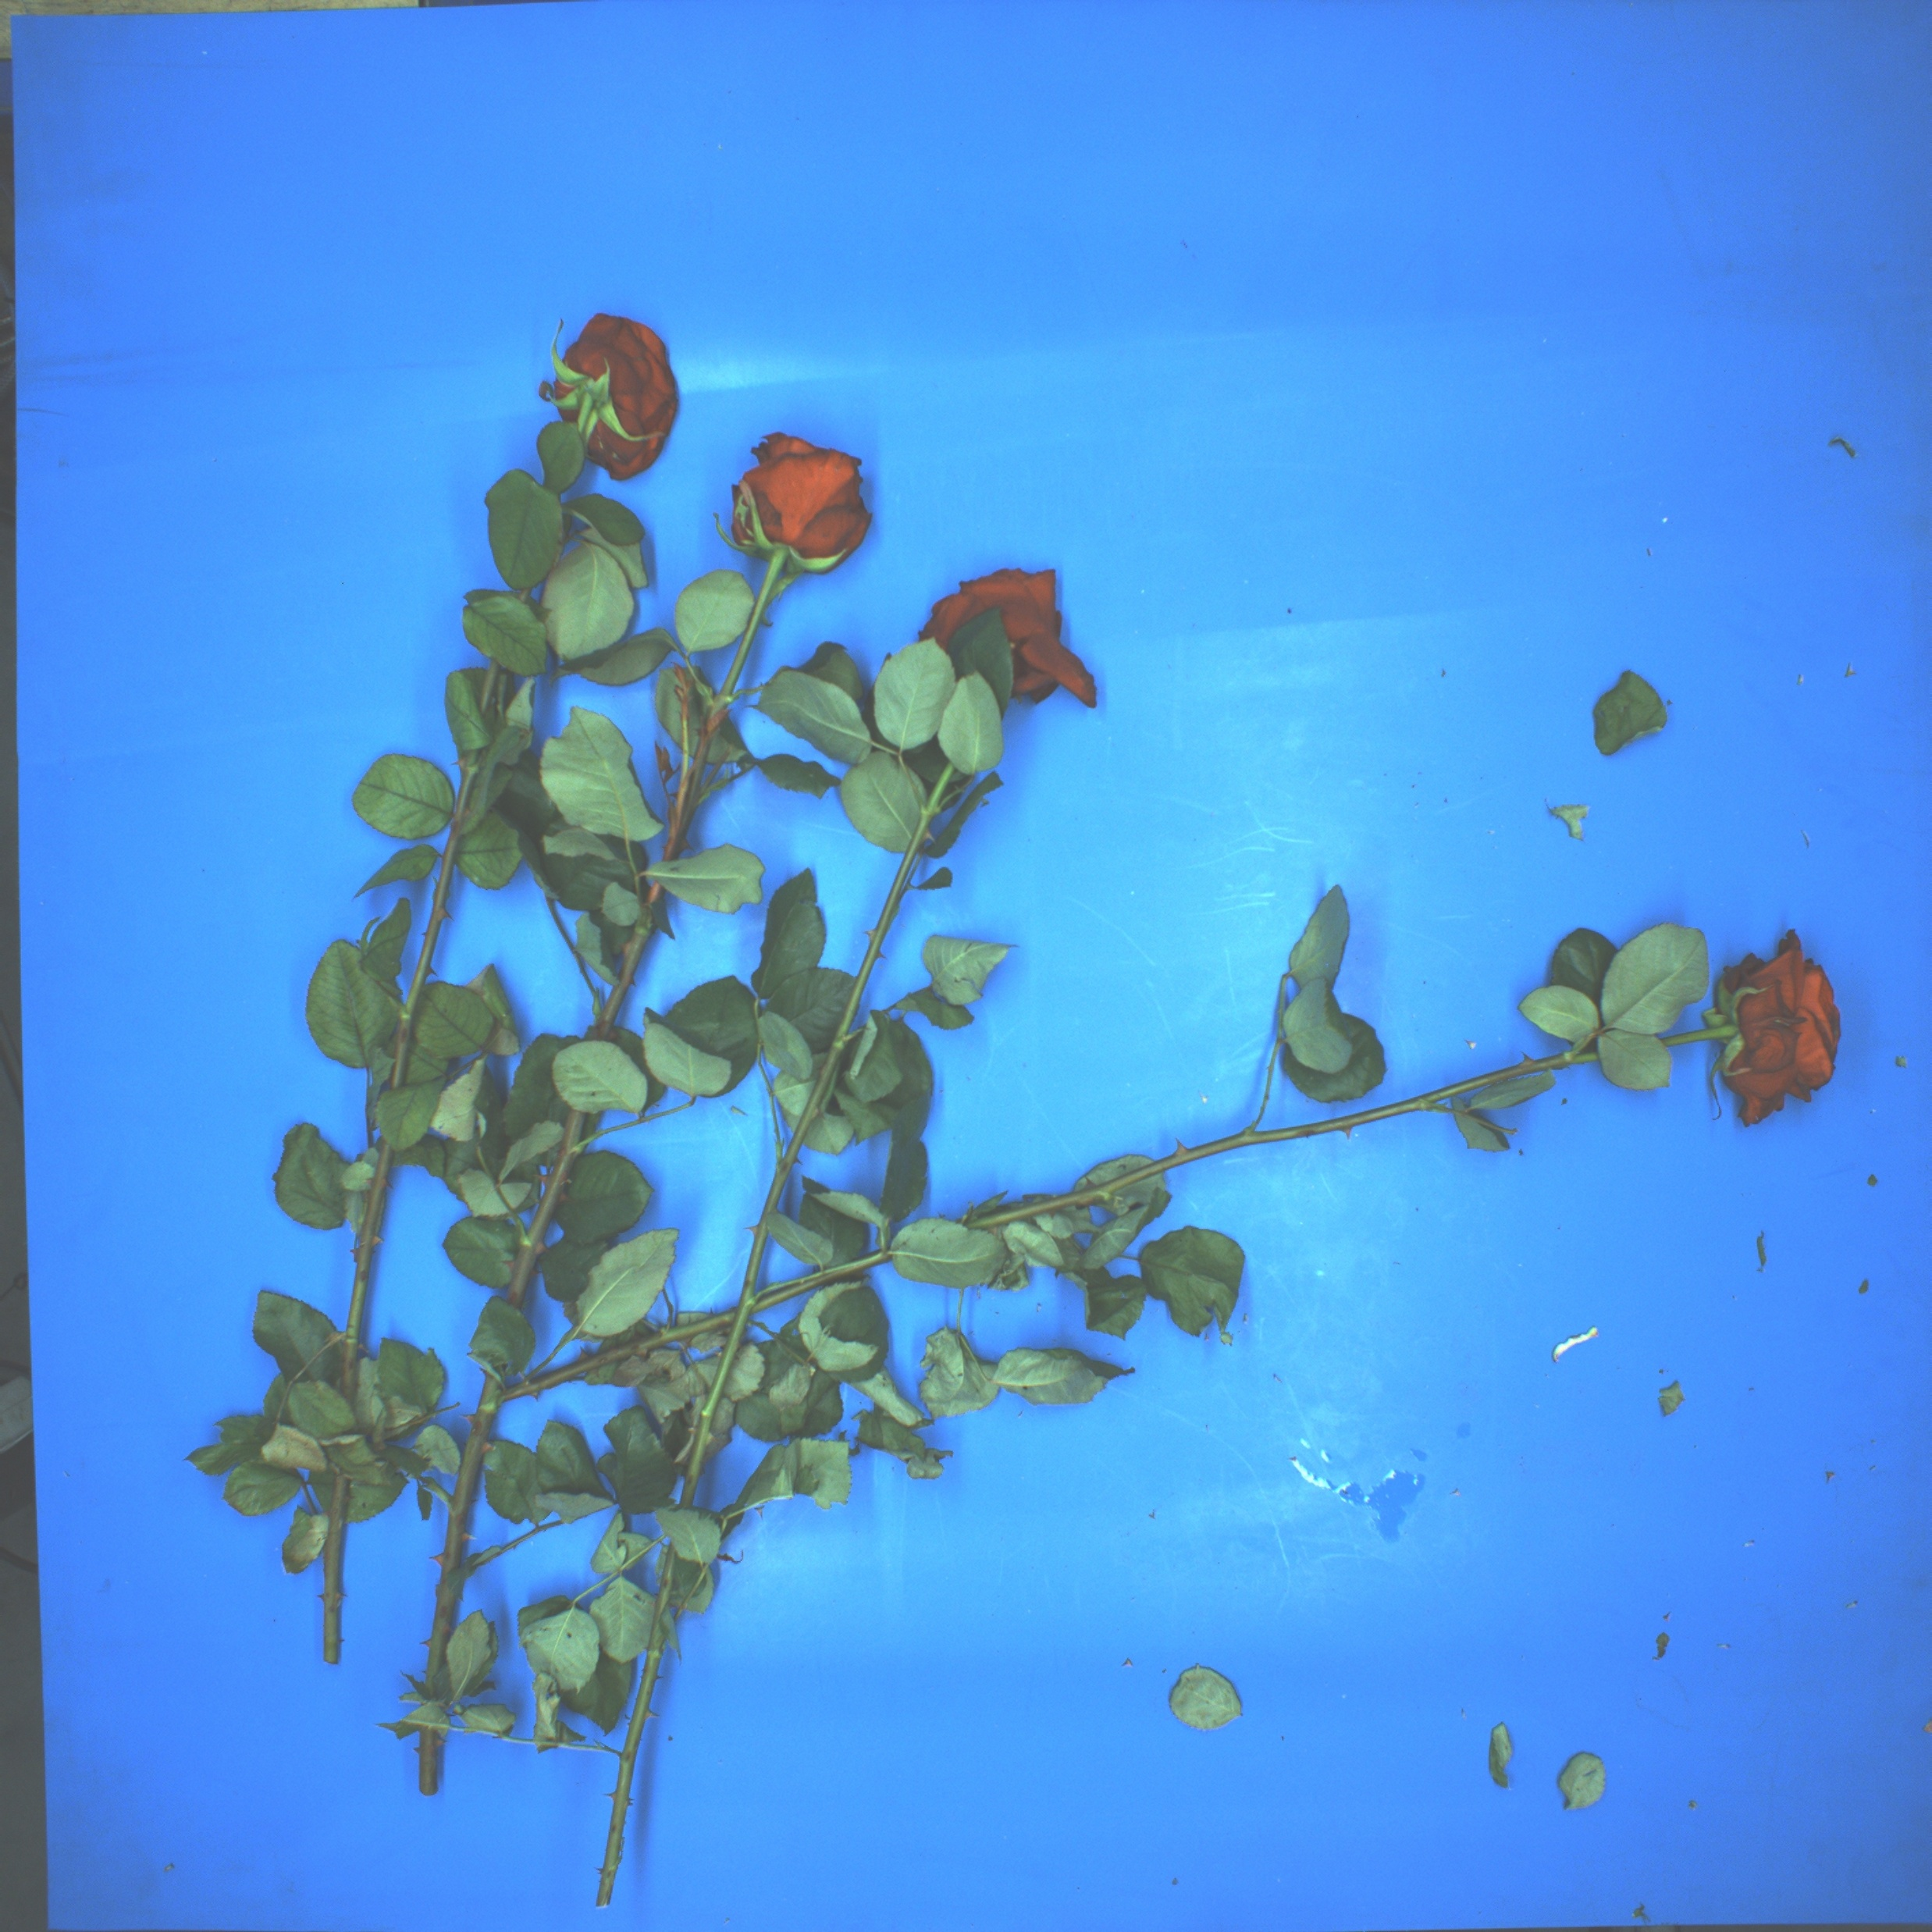
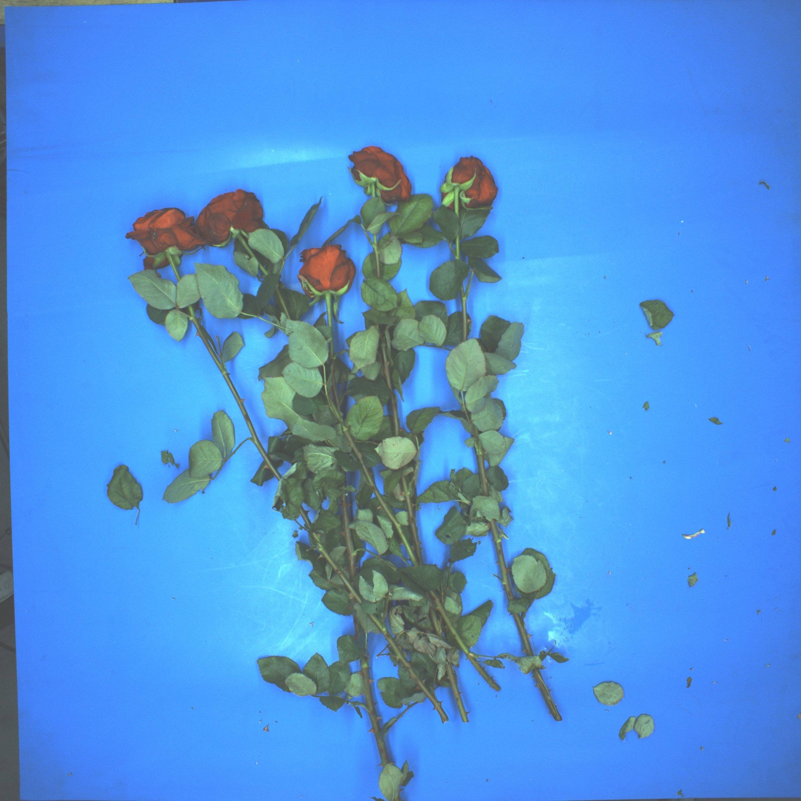
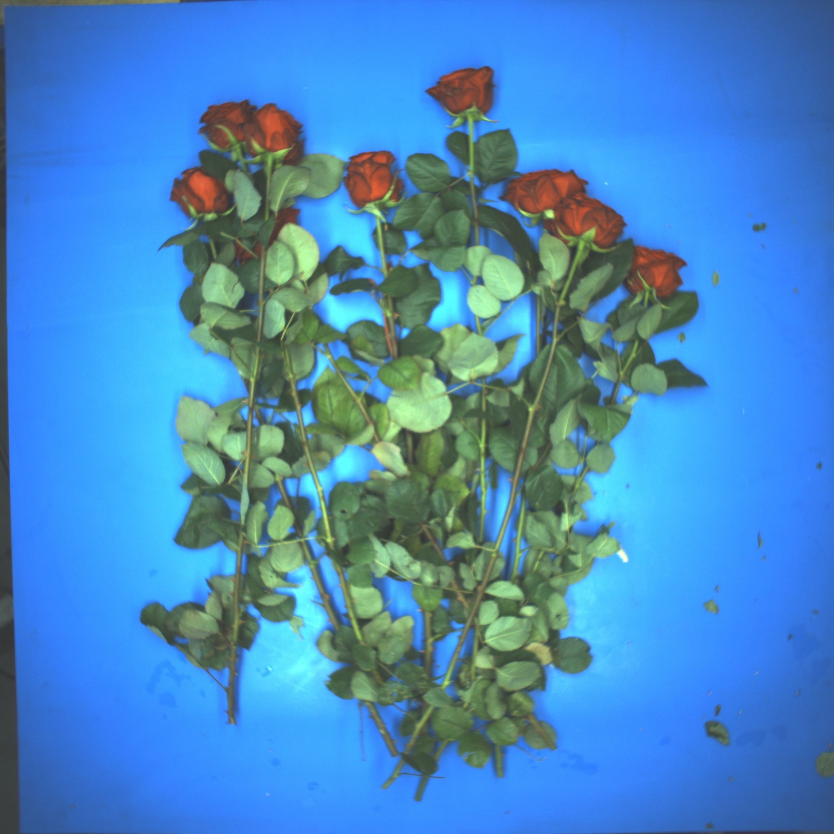
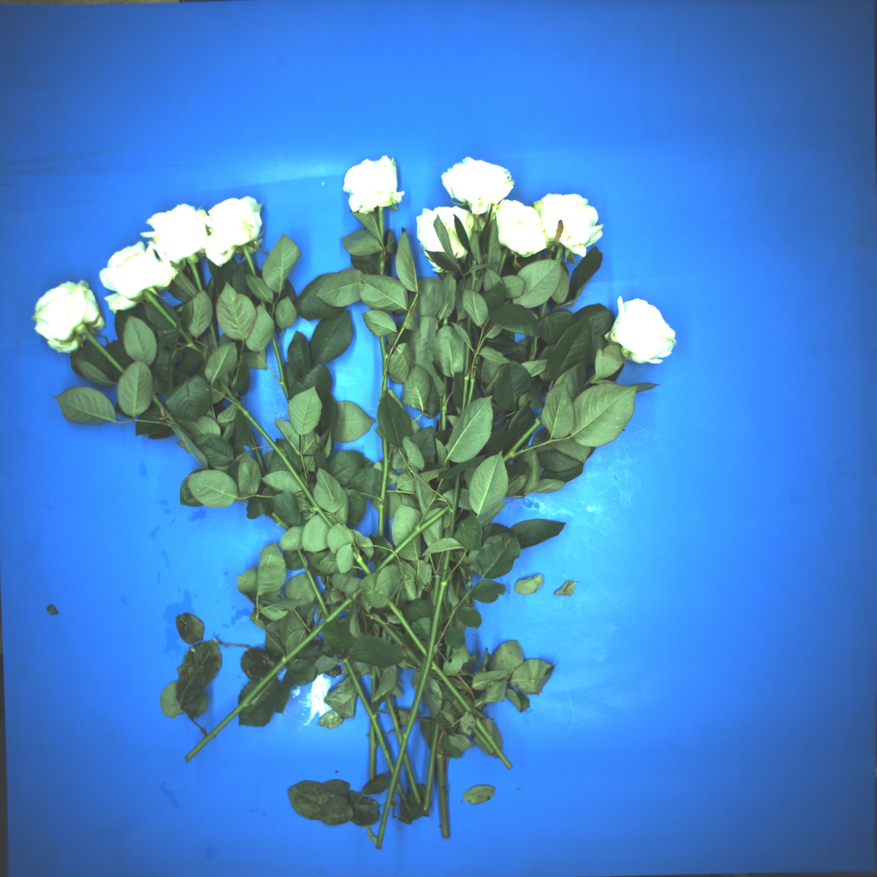
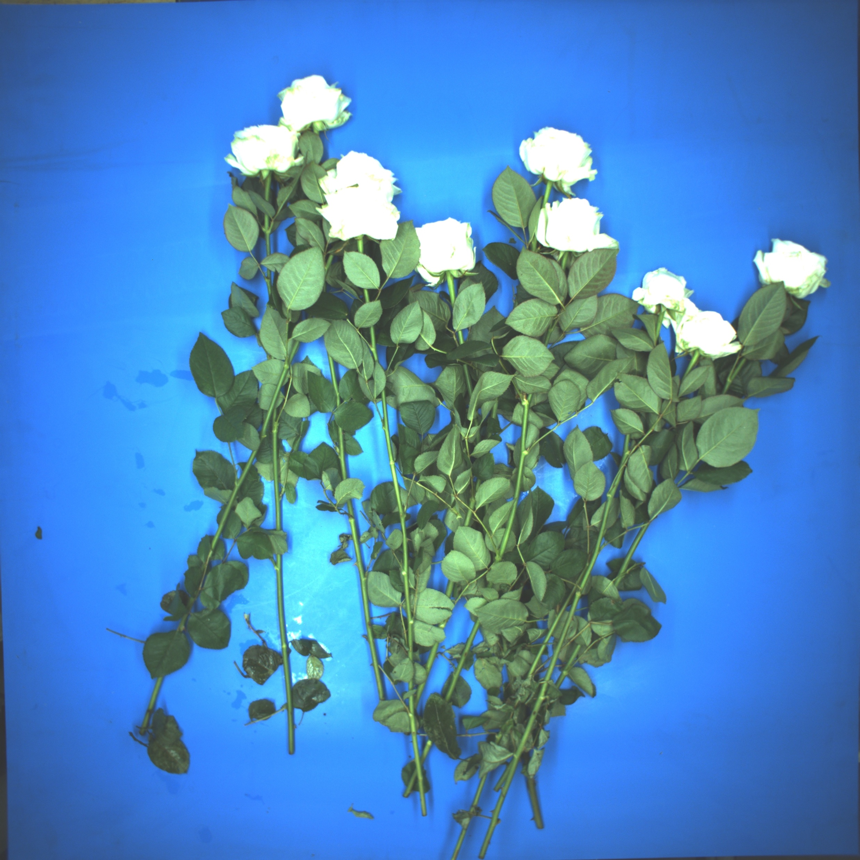
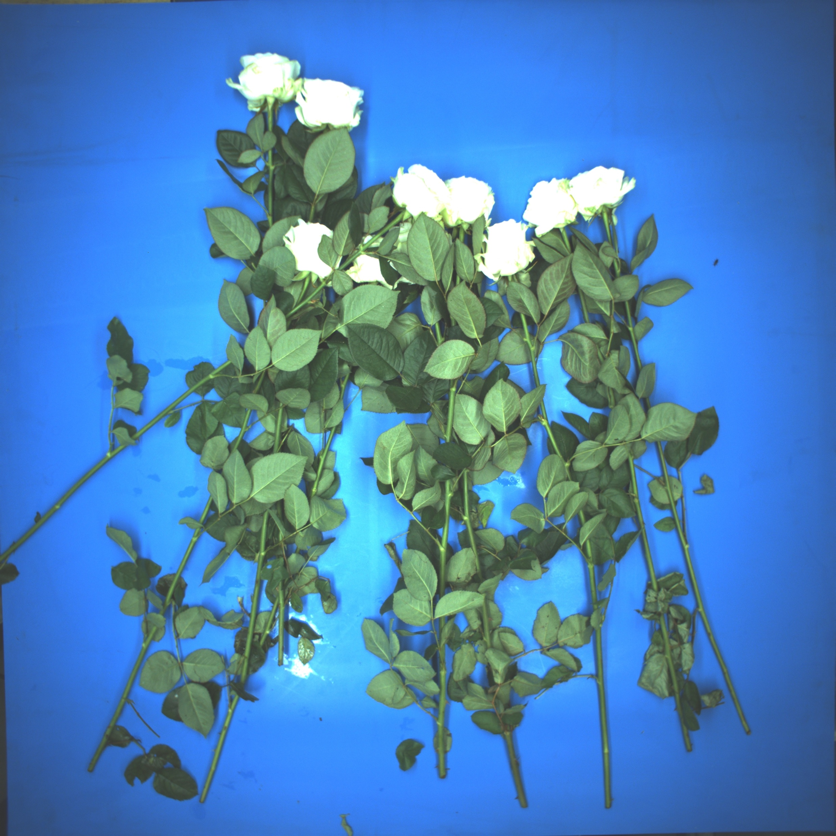
Annotaion and Model Training
Week 4 Hua Jiang

Slide 2
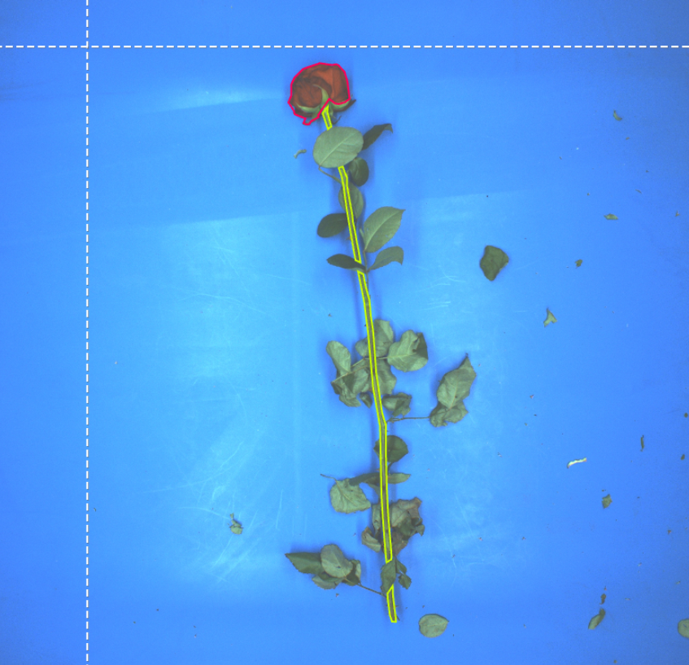
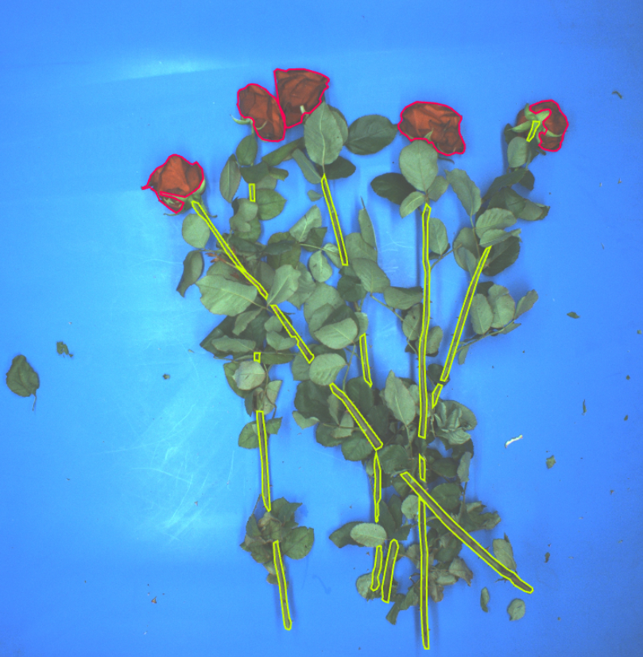
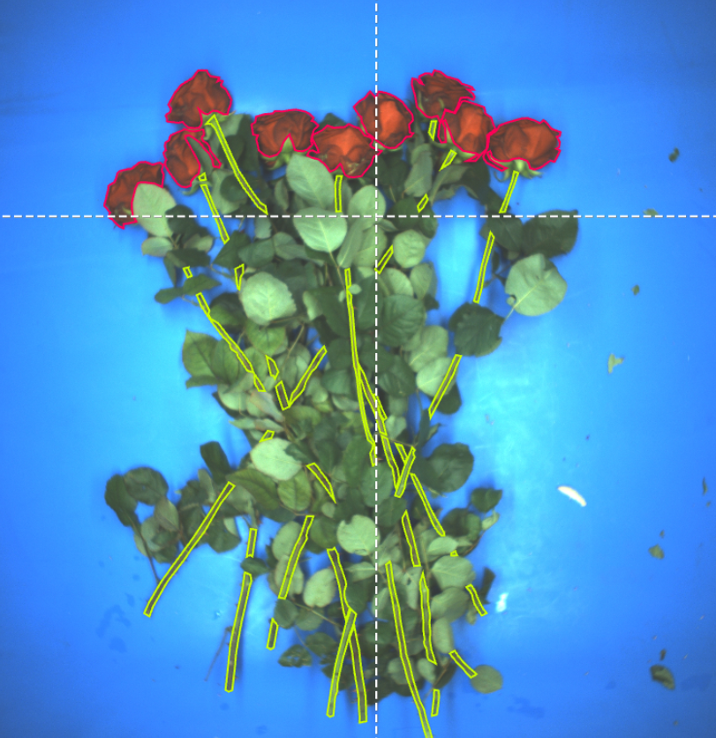
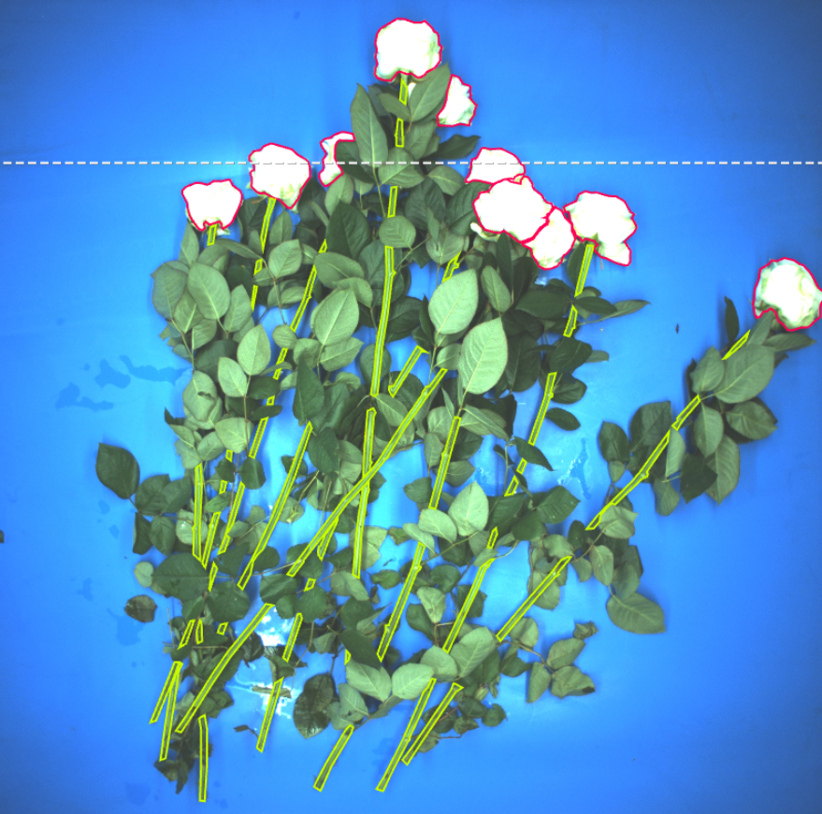
Dataset composition:
From 1 rose to 10 roses, 100 images in total

Slide 3
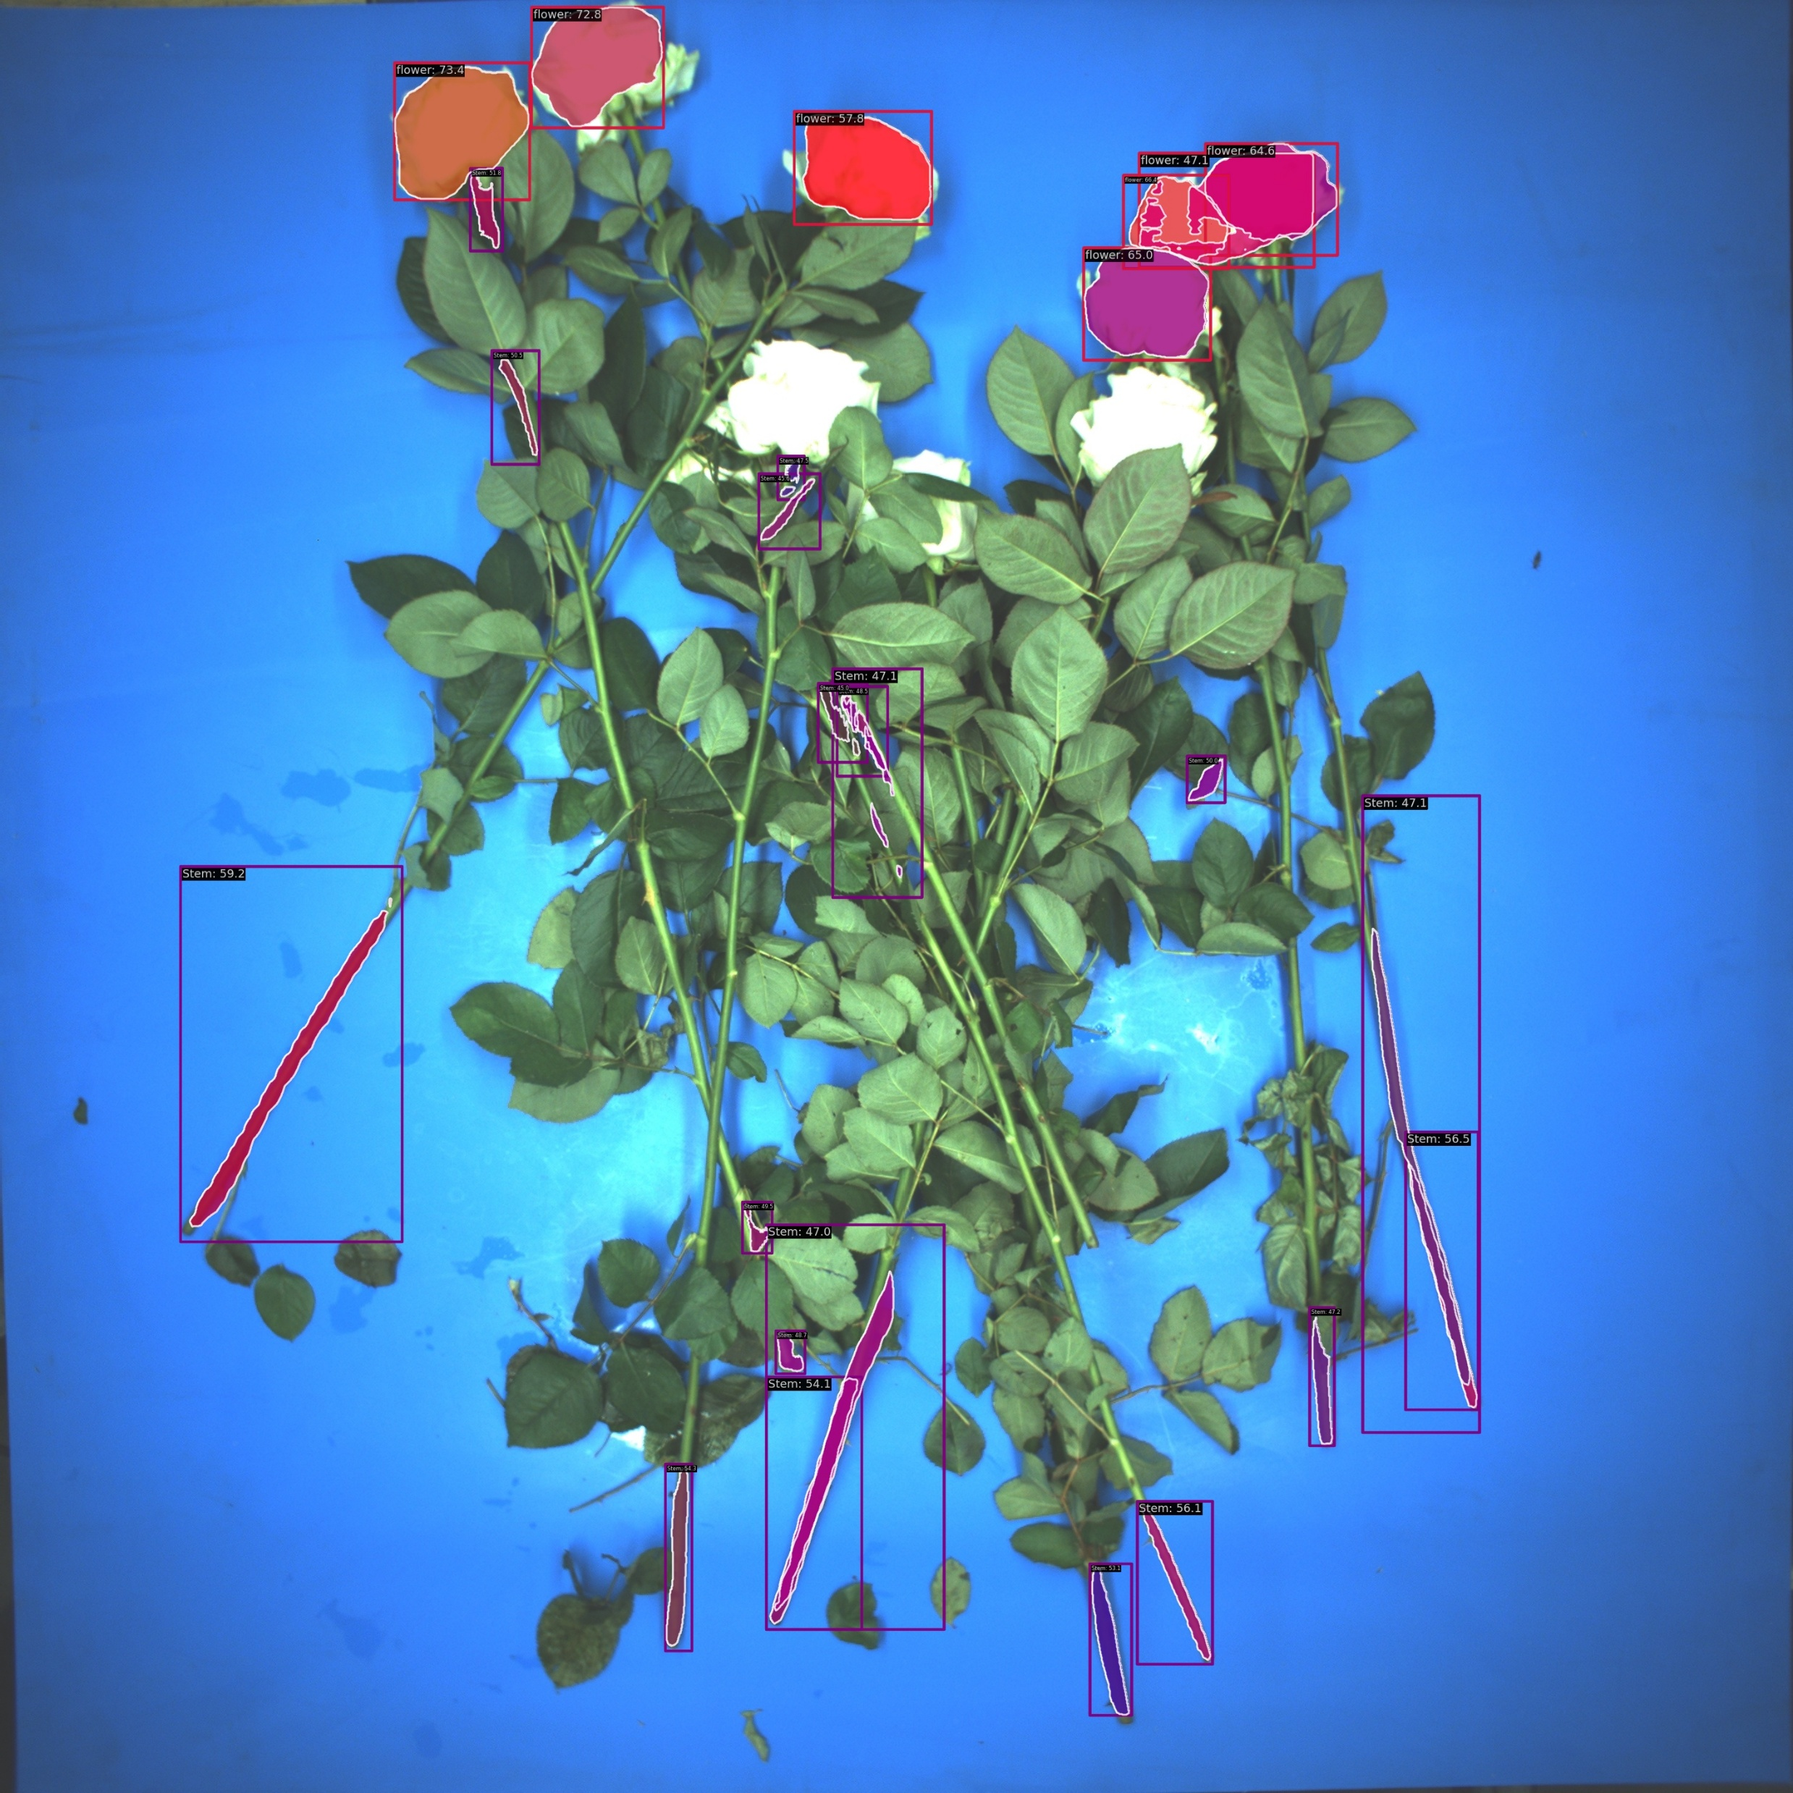
Able to tell two classes: stem and flower
Able to segment the stems and flowers from the blue background
Test 1:
mmdetection, Mask-RCNN
25 images, 12 epochs

Slide 4
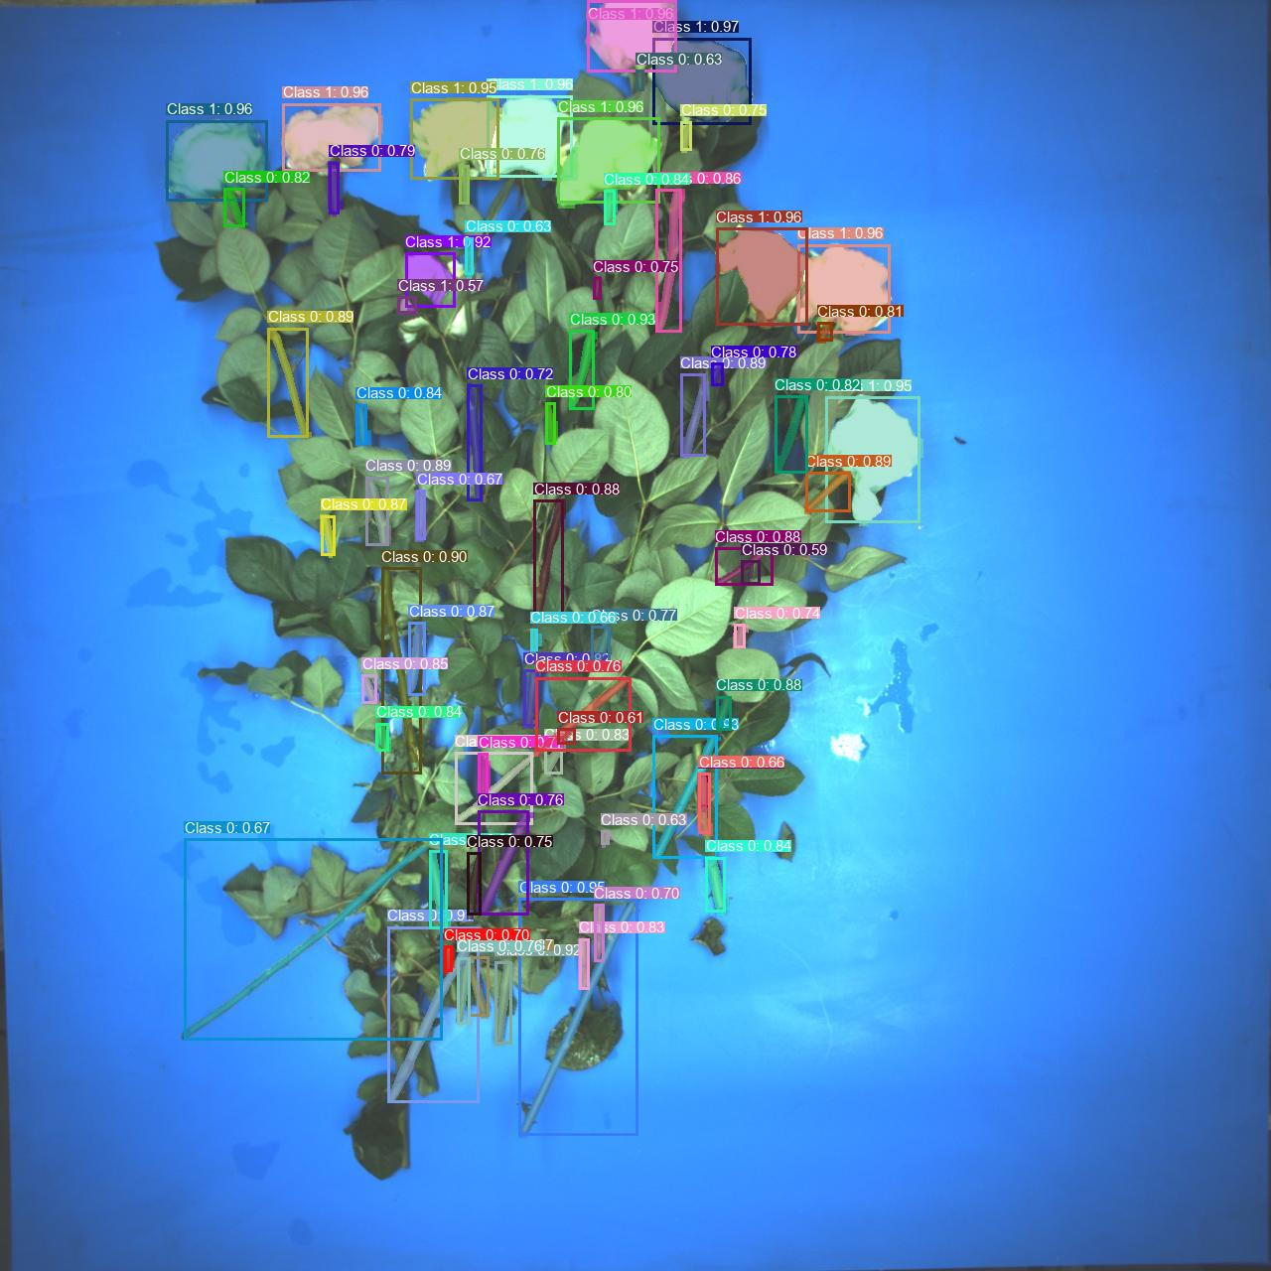
Able to segment the majority of stems and flowers with high confidence score!
Test 2:
YOLOv8 + Mask-RCNN
35 images, 300 epochs

Slide 5
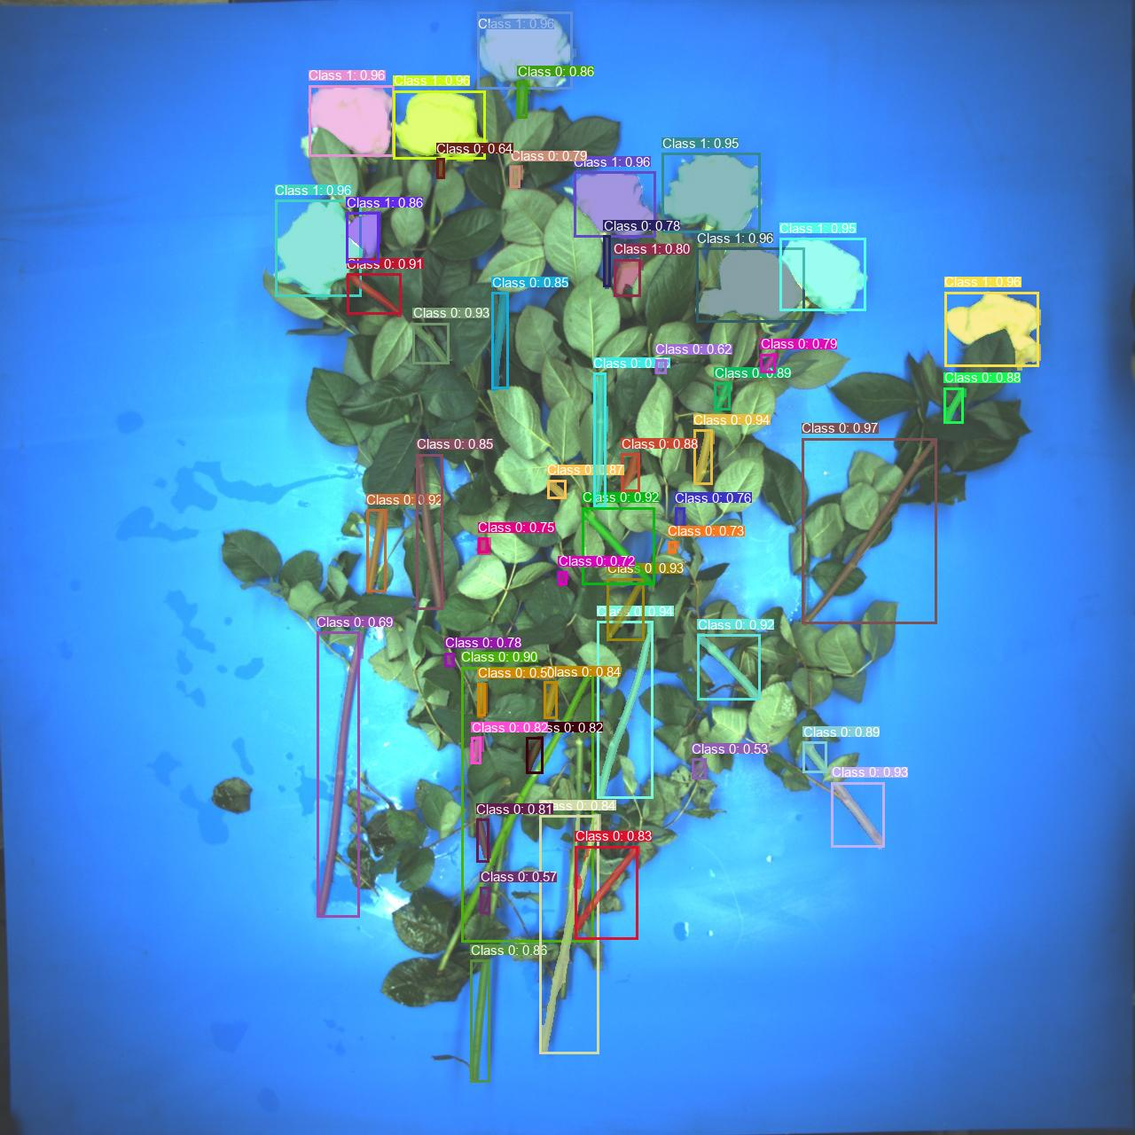
Able to segment the majority of stems and flowers with high confidence score!
Test 2:
YOLOv8 + Mask-RCNN
35 images, 300 epochs

Slide 6
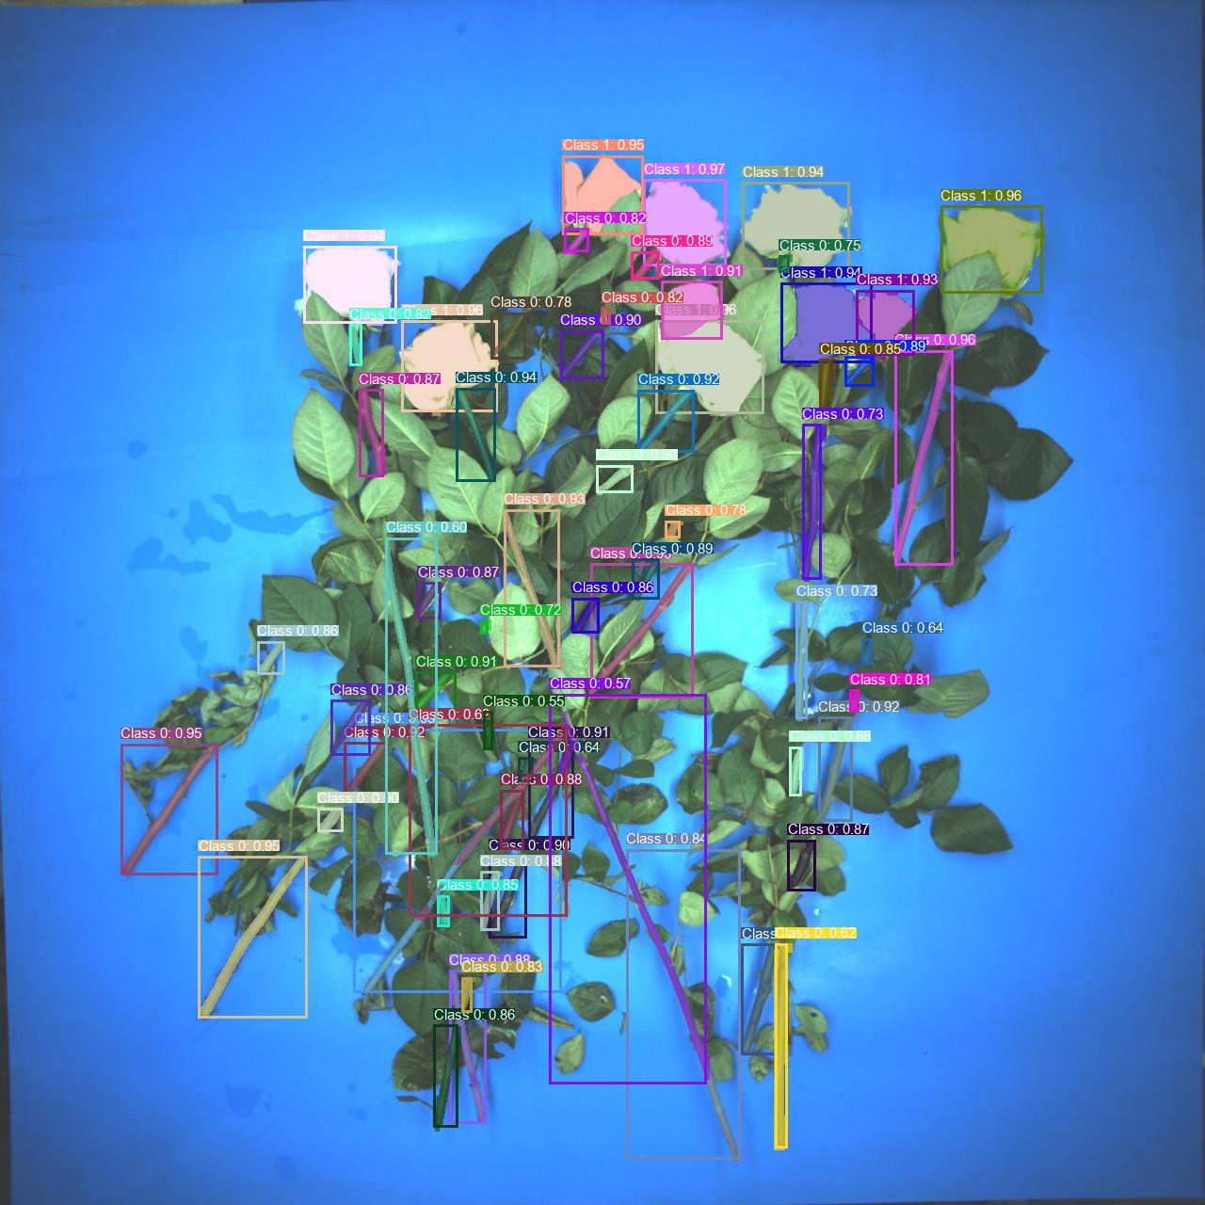
Able to segment the majority of stems and flowers with high confidence score!
Test 2:
YOLOv8 + Mask-RCNN
35 images, 300 epochs

Slide 7
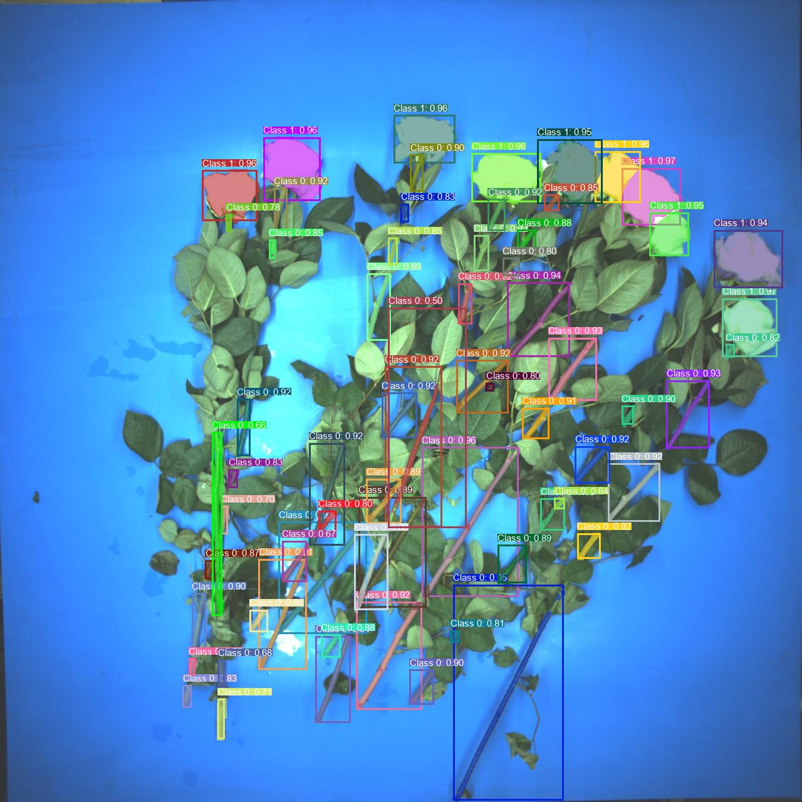
Able to segment the majority of stems and flowers with high confidence score!
Test 2:
YOLOv8 + Mask-RCNN
35 images, 300 epochs

Slide 8
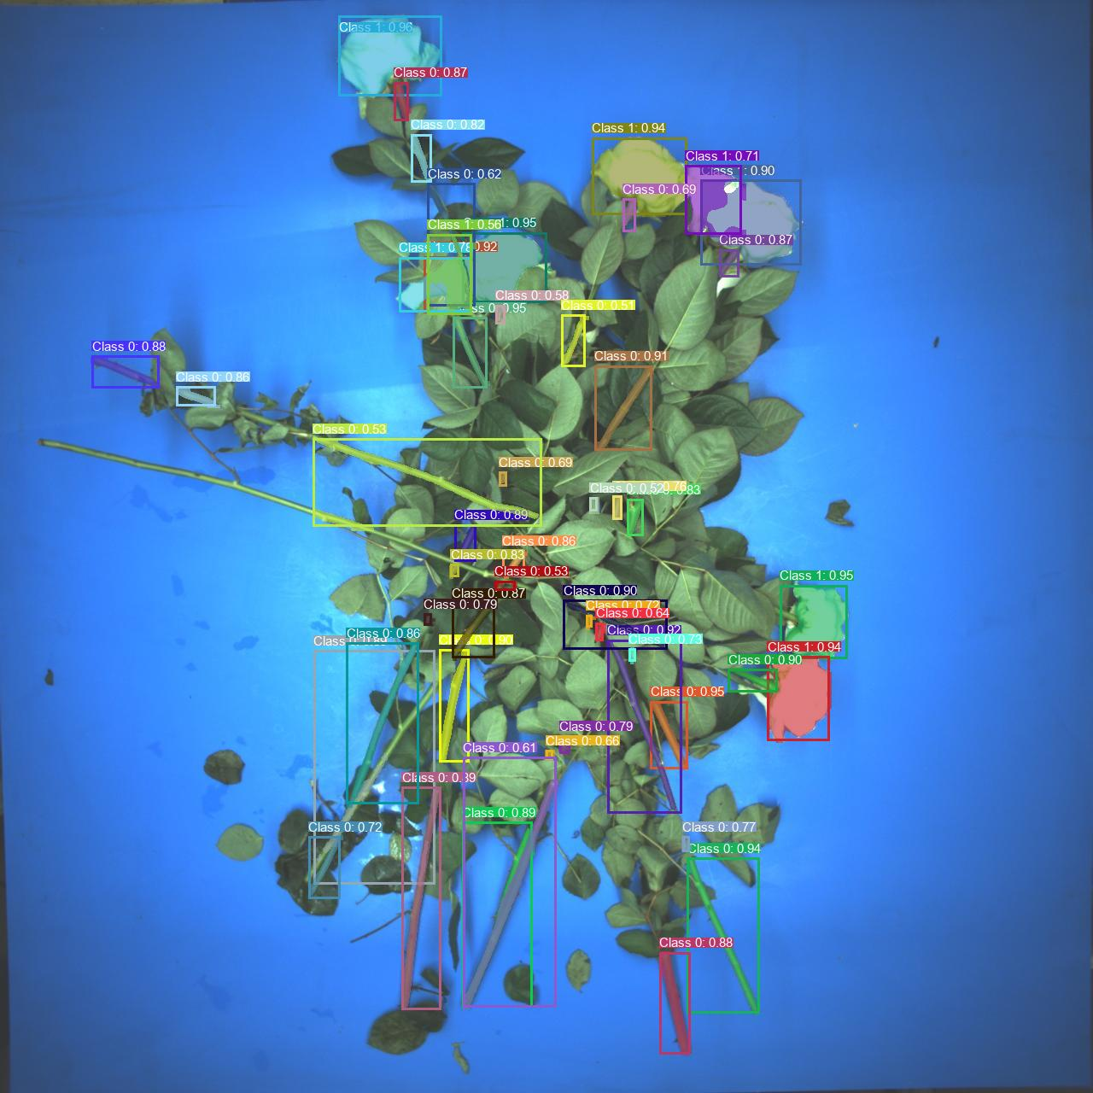
Able to segment the majority of stems and flowers with high confidence score!
Somtimes unable to detect the long stem segment
Test 2:
YOLOv8 + Mask-RCNN
35 images, 300 epochs

Slide 9
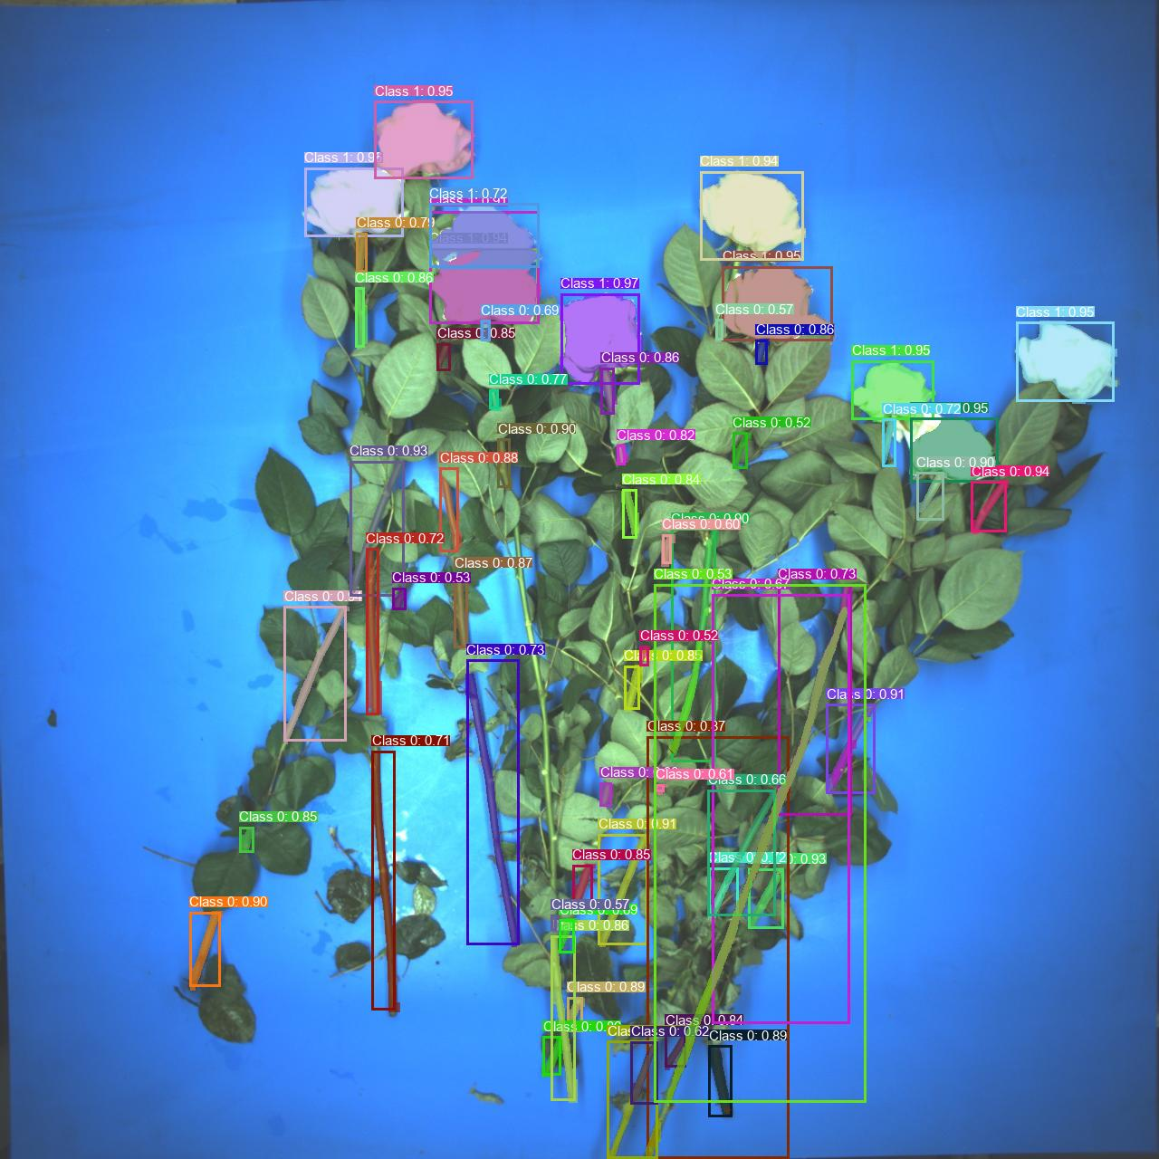
Able to segment the majority of stems and flowers with high confidence score!
Somtimes unable to detect the long stem segment
Test 2:
YOLOv8 + Mask-RCNN
35 images, 300 epochs

Slide 10
Future Work:
(1) Enlarge the dataset
(2) Compare the model performance between YOLO and Mmdetection
(3) Move to next phase: Anchor and Stem line proposal

